Slide 1

Hotel Booking Management System
Akshy S
Alla Harika Devi
Archana S Ajith
Mallu Likhitha
Naga Sai Rakshith B S
Sabah Khanam M S

Slide 2
Contents
Introduction
Problem Statement
Road Map
Features
Modules
Diagrams
Demonstration
Conclusion

Slide 3
Introduction
The Hotel Booking System Project is a software website through which the guests or user can secure online reservations. The user can choose all the relavant available options pertaining to the rooms and book them accordingly
It is user-friendly. It must show all the essential or crucial hotel-related data. If the portal shows up data correctly, users will have more confidence in booking the hotels. This advanced Hotel Booking System Project features a centralized database handling process.

Slide 4
Problem Statement
To Create an Application for Hotel Booking Management System
Customer should be able to view the list of hotels, rooms available.
Customer should be able to book the rooms of the hotel.
Admin should be able to perform these operations:
1.Hotel Management
2.Rooms management
3. Payments

Slide 5
Road-Map
Core Java +JPA with Hibernate
Spring Boot + Rest Controller + JPA with Hibernate
React for UI design (Front End) + Integration with previous Sprint

Slide 6

FEATURES
Better and efficient service provided.
Faster retrieval of information.
Reduced workload
All details of the users will be available on a click.

Slide 7
Modules
Login Module
Customer Module
Hotel Management Module
Room Management Module
Rooms Booking Management Module
Payment Management Module

Slide 8
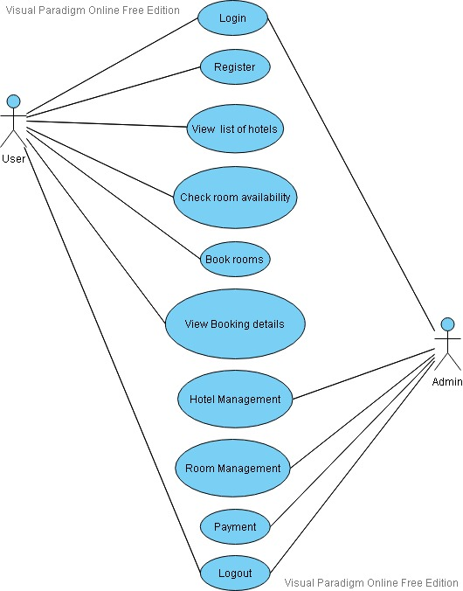
Use-Case Diagram

Slide 9
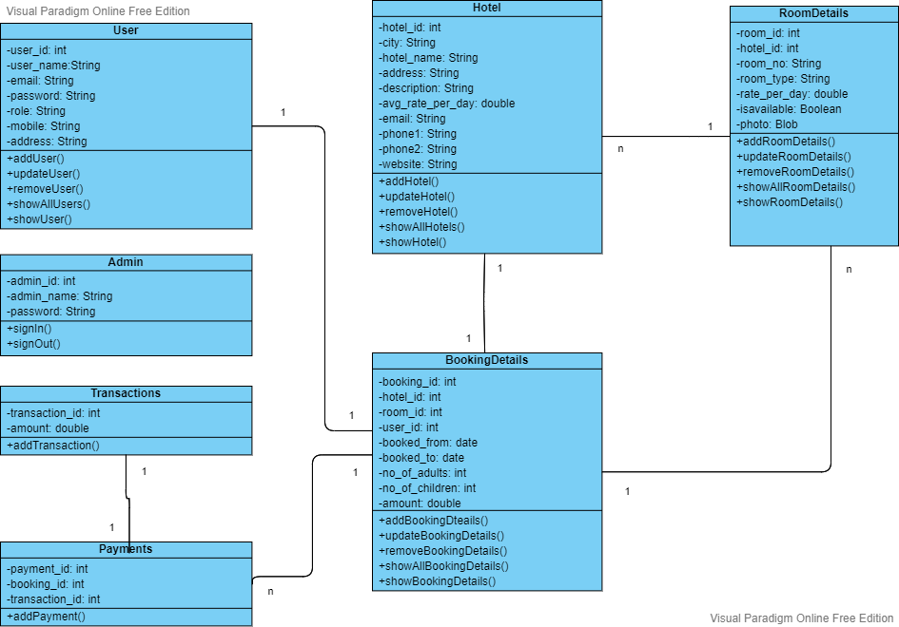
Class Diagram

Slide 10
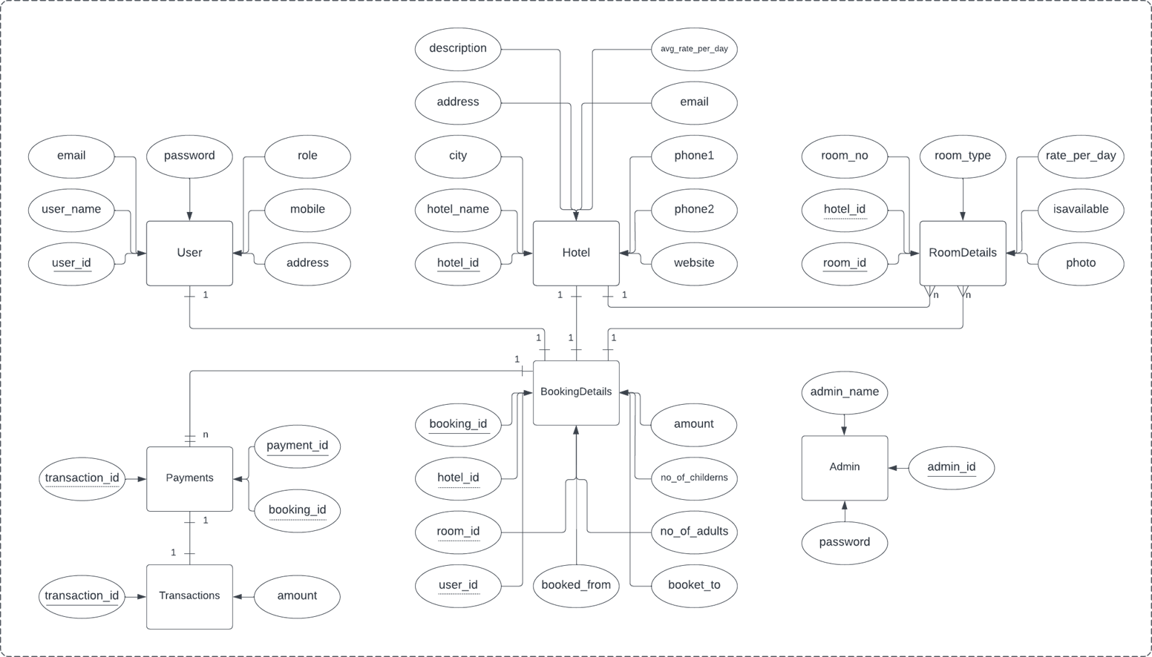
E-R Diagram

Slide 11
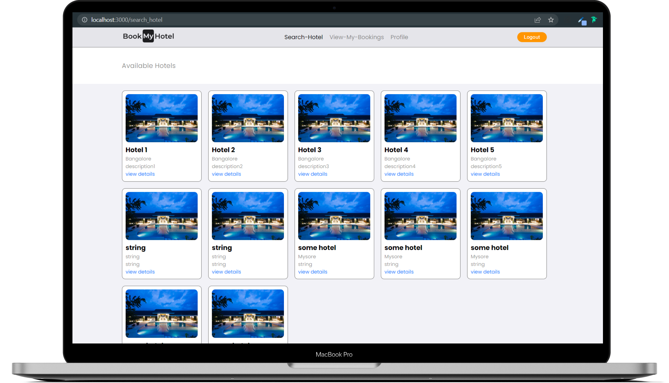
Demonstration

Slide 12
Conclusion
This is a prototype website that we have designed for an Online Hotel booking management system. The core reason for the establishment of this website is to enable the users a convenient, fair and smooth booking experience. The key concept is to minimise the usage of paper work and all the hassle one experiences while engaging in on-spot booking.
Future work includes adding more functionality like sending confirmation mails while the bookings are confirmed or cancelled to their personal mail ids and phone numbers etc.

Slide 13


Slide 14


